Slide 1
Fundamentals of Power Systems EE 303 – Final Project
Özyeğin unıversıty
Prepared by : Muhammet AKGÜL
Salih Emre KAYNAR

Slide 2
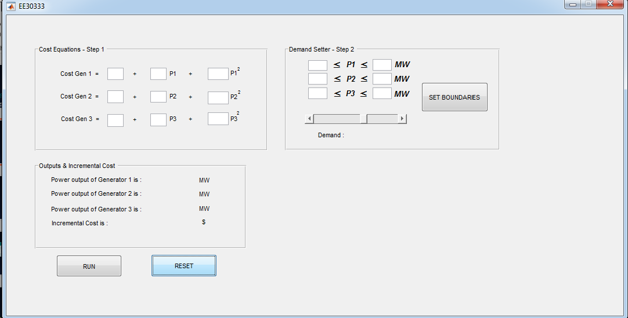
50
100
5
10
0.016
150
200
4
8
0.018
50
200
3
12
0.02
400

Slide 3
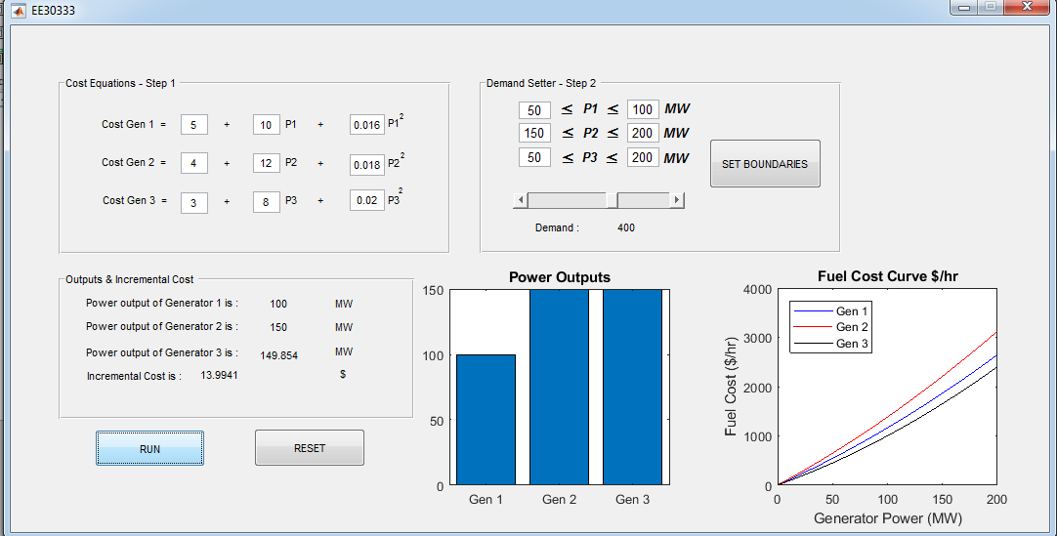

Slide 4
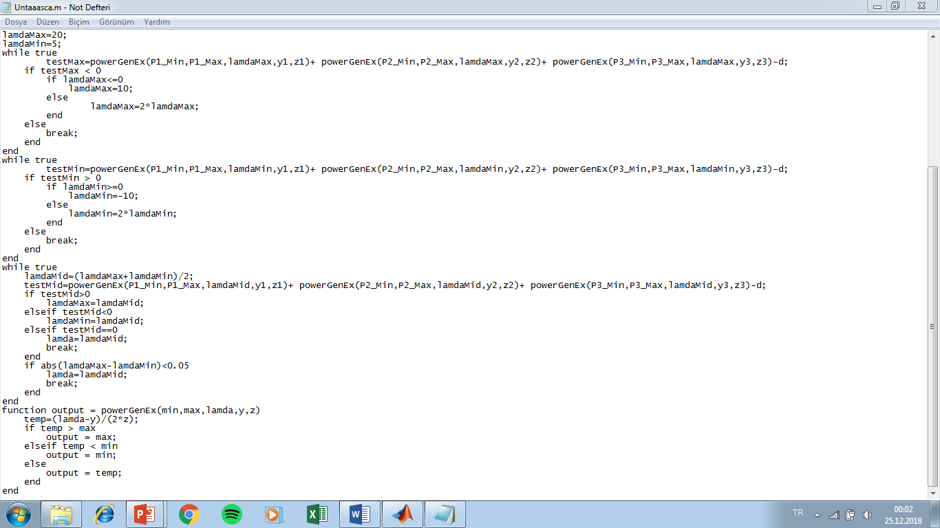
Initial guess for lamda
Lamda high checker
Lamda low checker
Main Algorithm
Function used in code

